Slide 1
ECE 424 – Introduction to VLSI Design
Emre Yengel
Department of Electrical and Communication Engineering
Fall 2013

Slide 2
Goals of This Course
Understand the manufacturing technologies of integrated semiconductor devices and integrated circuits
Learn to design and implement state-of-the-art digital Very Large Scale Integrated (VLSI) chips using CMOS technology
Learn to analyze sequential circuits designed by CMOS technology
Learn to analyze, simulate and test of the digital design by CAD tools (KICAD will be used)
Learn the basics of Xilinx FPGA

Slide 3
Course Information
Instructor
Emre Yengel
Office: L-A21
+90-312-233-1309
e.yengel@cankaya.edu.tr
More on Course
Course Web Page: ece424.cankaya.edu.tr
Text Book: Digital Integrated Circuits (2nd ed.), Jan M. Rabaey, 2002
Lectures in class will cover basics of course
Homeworks will help you gain a deep understanding of the subject
Assessment: HWs (%20), Attendance (%10), Midterm (%30), Final (%40)
Lab sessions will cover PSPICE and FPGA basics

Slide 4
VLSI Design
What is VLSI?
  “Very Large Scale Integration”
  Defines integration level
  1980s hold-over from outdated taxonomy for integration levels
    Obviously influenced from frequency bands, i.e. HF, VHF, UHF
  Sources disagree on what is measured (gates or transistors?)
SSI – Small-Scale Integration (0-10²)
MSI – Medium-Scale Integration (10²-10³)
LSI – Large-Scale Integration (10³-10⁵)
VLSI – Very Large-Scale Integration (10⁵-10⁷)
ULSI – Ultra Large-Scale Integration (>=10⁷)

Slide 5
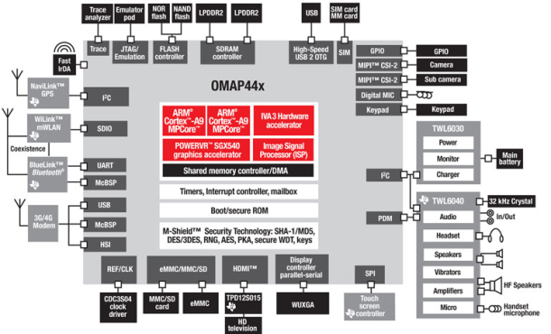
Example System-on-a-chip (SOC)
Source: TI

Slide 6
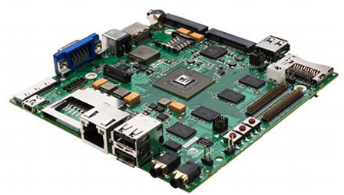
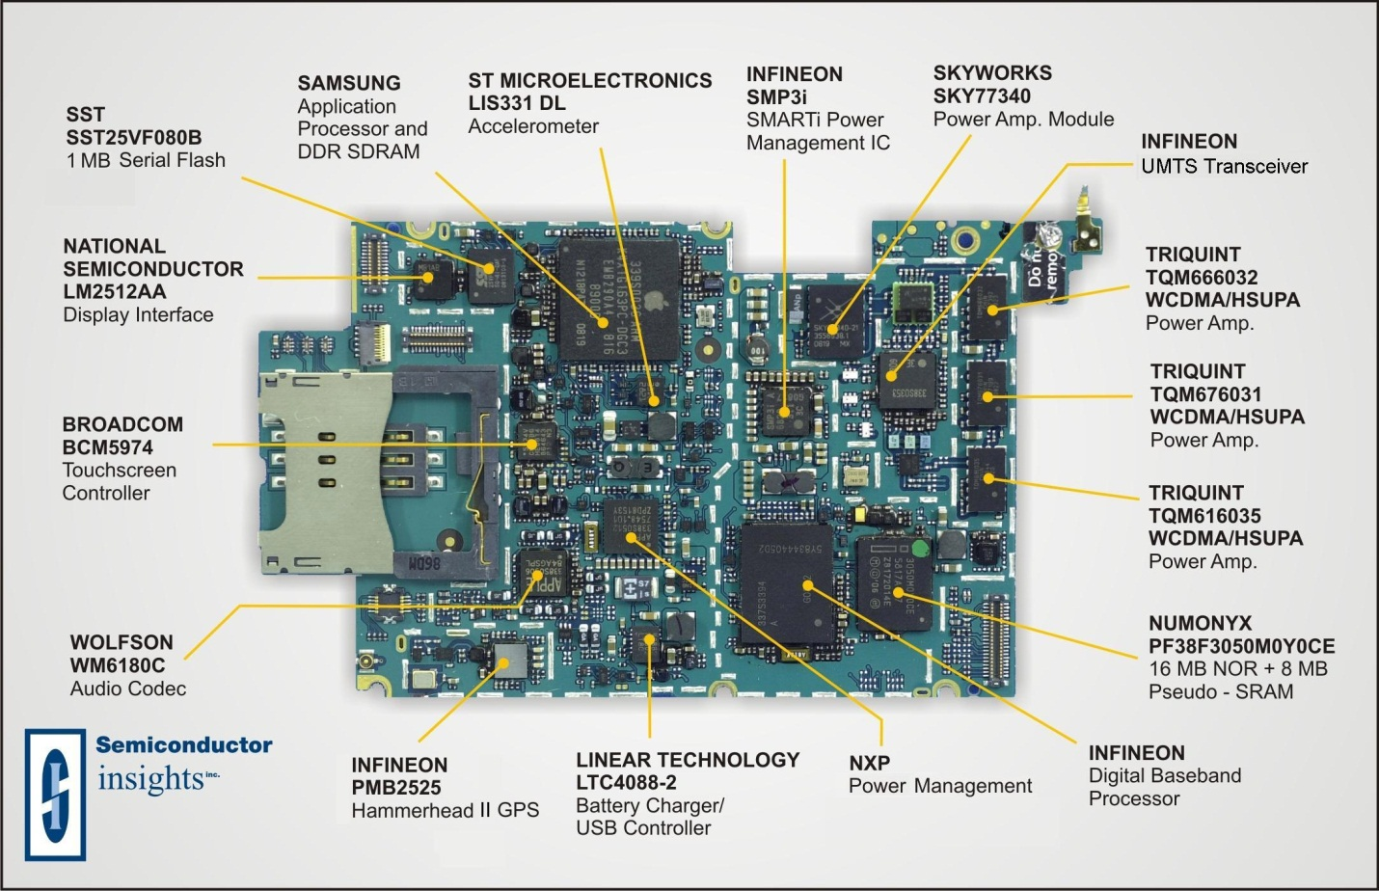
Example System-on-a-chip (SOC)
iPhone 3G board
TI OMAP44x

Slide 7
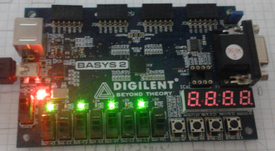
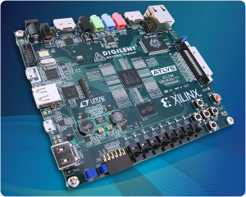
Boards to be used in this class
Xilinx Spartan 3E FPGA Development Board
Atlys™ Spartan-6 FPGA Development Board

Slide 8
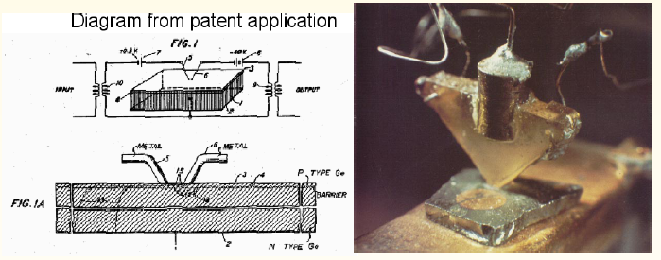
History of the Transistor
Early ideas of transistors started with the theoretical studies of J.W. Lilienfelds in 1930s.
1947: Bardeen and Brattain create point contact transistor at Bell Laboratories. (U.S. Patent 2,524,035)

Slide 9
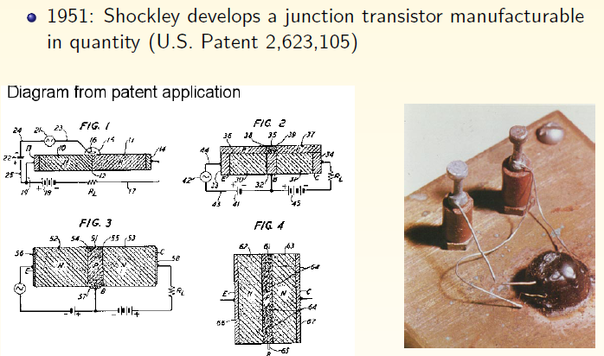
History of the Transistor

Slide 10
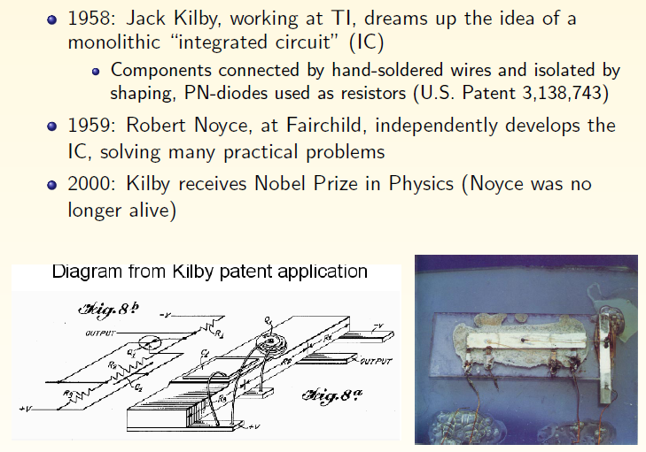
History of the Transistor

Slide 11
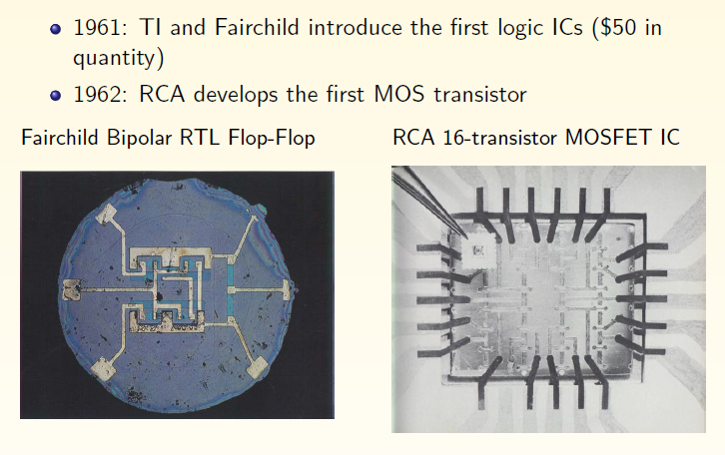
History of Transistor

Slide 12
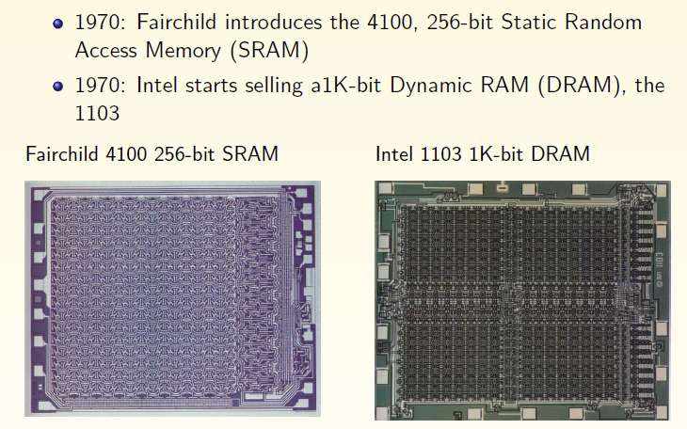
History of Transistor

Slide 13
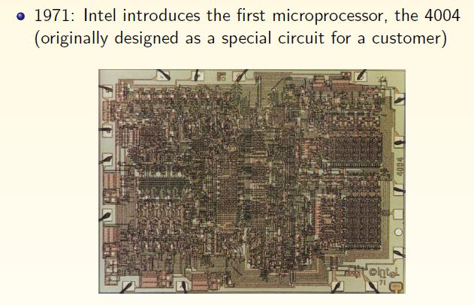
History of Transistor

Slide 14
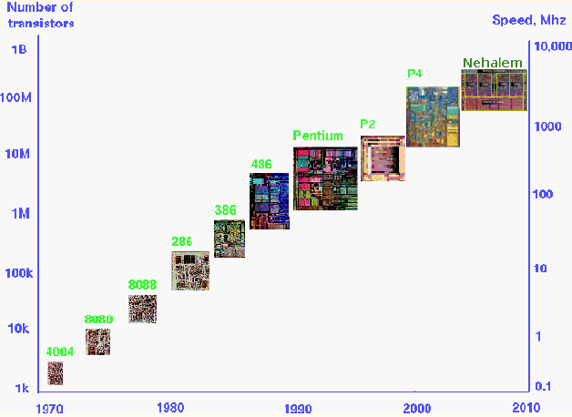
History of Transistor

Slide 15
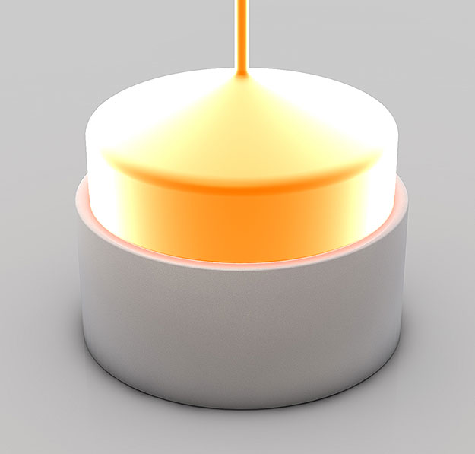
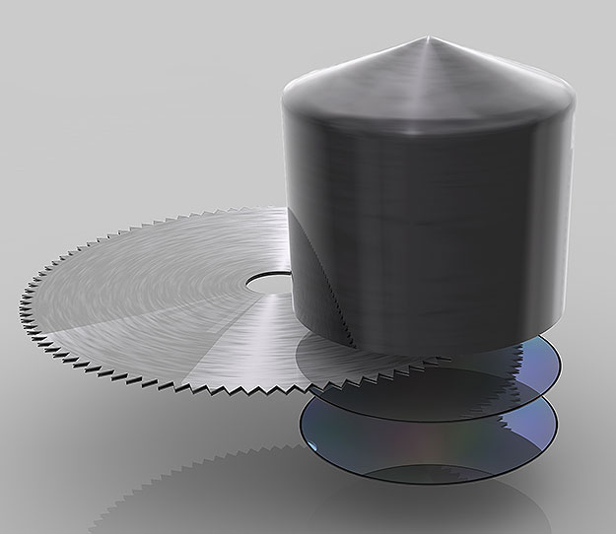
Integrated circuits on wafers
In this picture you can see how one big crystal is grown from the purified silicon melt. The resulting mono crystal is called Ingot.
The Ingot is cut into individual silicon discs called wafers

Slide 16
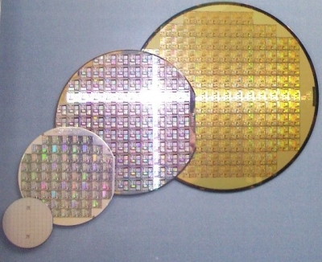
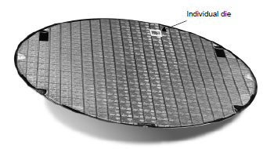
Cost of an IC
The total cost of a product can be separated into two components: the recurring expenses (variable cost) and the non-recurring expenses (fixed cost).
Fixed cost; man-power, company’s R&D, manufacturing equipment, marketing, sales, building infrastructures,…
Variable cost; directly attributes to a manufactures product and is proportional to the product volume.

Slide 17

Cost of an IC
α is a parameter that depends upon the complexity of the manufacturing process and roughly proportional to the number of masks.α=3 is a good estimate for today’s complex CMOS process.
Cost per die is a strong function of the die area.

Slide 18
Types of ICs
IC designs can be Digital (covered in this course), Analog, RF or mixed-signal.
Digital Designs;
  Full Custom (FPGA(Field Programmable Gate Array),CPGA,..)
    Every transistor designed and laid out by hand
    Used for memories, datapaths in high performance processors, etc.
  ASIC (Application Specific Integrated Circuit)
    Designs synthesized automatically from a high-level language description
  Semi-Custom
    Mixture of custom and synthesized modules

Slide 19
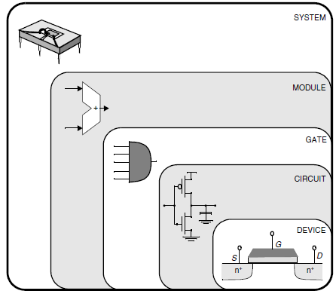
Digital VLSI
In digital world, the internal details of a complex module can be abstracted away and replaced with a black box view or model.
The performance of this model is considered with known characteristics. Unlike analog designs, the impact of this divide and conquer approach is dramatic.
Design abstraction levels in digital circuits

Slide 20
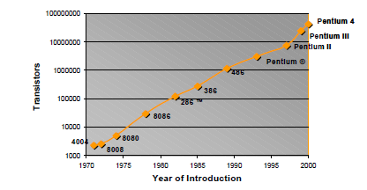
Issues in ICs
Moore's law is the observation that over the history of computing hardware, the number of transistors on integrated circuits doubles approximately every two years.

Slide 21
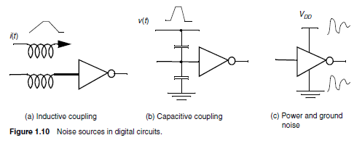
Functionality and Robustness
NOISE: ‘unwanted variations of voltages and currents at the logic nodes’

Slide 22




Functionality and Robustness
Digital circuits (DC) perform operations on logical (or Boolean) variables.
Inversion
A logical variable is a mathematical abstraction. In a physical implementation, such a variable is represented by an electrical quantity. This is most often a node voltage that is not discrete but can adopt a continuous range of values.
This electrical voltage is turned into a discrete variable by associating a nominal voltage level with each logic state:
1 VOH, 0 VOL, where VOH and VOL represent the high and the low logic levels, respectively.

Slide 23
Functionality and Robustness
Representing logic levels with digital voltages
  Ground (GND, VSS) = 0V - can represent logic 0
  Power supply (V_{DD}) can represent logic 1
Decreasing voltages
  In 1980s, V_{DD} = 5V
  V_{DD} has been decreasing in modern processes
  High V_{DD} would damage modern tiny transistors
  Lower V_{DD} saves power
  VDD = 3.3V; 2.5V; 1.8V; 1.5V; 1.2V; 1.0V; 0.9V; …

Slide 24
Functionality and Robustness
The Voltage-Transfer Characteristics
The electrical function of a gate is best expressed by its voltage-transfer characteristic (VTC) (sometimes called the DC transfer characteristic), which plots the output voltage as a function of the input voltage Vout = f(Vin).
Vm : Gate or switching voltage
This point will be of particular interest when studying sequential circuits.
Inverter voltage-transfer characteristics

Slide 25

Functionality and Robustness
Noise Margins : A measure of the sensitivity of a gate to noise is given by the noise margins NML (noise margin low) and NMH (noise margin high), which quantize the size of the legal “0” and “1”, respectively, and set a fixed maximum threshold on the noise value:

Slide 26

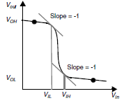
Functionality and Robustness
Regenerative Property: If the gate possesses the regenerative property, the effect of different noise sources can not force a signal level into the undefined region.
Definition of VIL and VIH

Slide 27
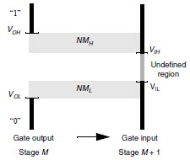
Functionality and Robustness
As long as the signal is within the noise margins, the following gate continues to function correctly, although its output voltage varies from the nominal one. This deviation is added to the noise injected at the output node and passed to the next gate.

Slide 28

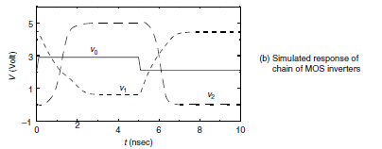
Functionality and Robustness
For a chain of even number of inverters, the output voltage vout will equal VOL if and only if the inverter possesses the regenerative property.

Slide 29
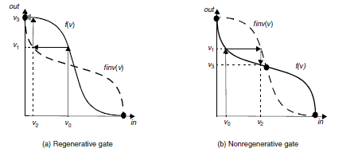
Functionality and Robustness
VTC of an inverter Vout = f(Vin) as well as its inverse function finv(), which reverts the function of the x- and y-axis and is defined as follows:

Slide 30
Functionality and Robustness
Noise Immunity: expresses the ability of the system to process and transmit information correctly in the presence of noise.
A system with good noise immunity must reject the noise instead of overpowering it.
Directivity: a gate to be unidirectional which changes in an output level should not appear at any unchanging input of the same circuit.

Slide 31
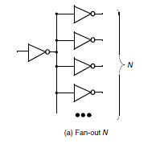
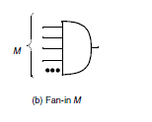
Functionality and Robustness
Fan In & Fan Out: The fan-out denotes the number of load gates N that are connected to the output of the driving gate. The fan-in of a gate is defined as the number of inputs to the gate.

Slide 32
Performance
Performance of a digital circuit can be expressed with the computational ability that the circuit can manage. It is often expressed by the duration of the clock period (clock cycle time), or its rate (clock frequency).
The propagation delay tp of a gate defines how quickly it responds to a change at its input(s). It expresses the delay experienced by a signal when passing through a gate. It is measured between the 50% transition points of the input and output waveforms

Slide 33

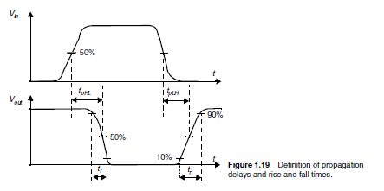
Performance
The tpLH defines the response time of the gate for a low to high (or positive) output transition, while tpHL refers to a high to low (or negative) transition. The propagation delay tp is defined as the average of the two.

Slide 34
Performance
The delay is a function of the slopes of the input and output signals of the gate. To quantify this, the rise and fall times tr and tf, which express how fast a signal transits between the different levels.
The rise/fall time of a signal is largely determined by the strength of the driving gate, and the load presented by the node itself, which sums the contributions of the connecting gates (fan-out) and the wiring parasitics.

Slide 35

Performance
The de-facto standard circuit for delay measurement is the ring oscillator, which consists of an odd number of inverters connected in a circular chain.
The period T of the oscillation is determined by the propagation time of a signal transition through the complete chain, or T = 2 x tp x N with N the number of inverters in the chain.
Typically, a ring oscillator needs a least five stages to be operational.

Slide 36

Performance
Propagation Delay of a first-order IC network;
Transient response of this circuit;
The time to reach the 50% point is easily computed as t = ln(2)t = 0.69t. Similarly, it takes t = ln(9)t = 2.2t to get to the 90% point.

Slide 37
Power and Energy Consumption
The power consumption of a design determines how much energy is consumed per operation, and how much heat the circuit dissipates.
These factors influence a great number of critical design decisions;
  the power-supply capacity
  the battery lifetime
  supply-line sizing
  packaging and cooling requirements
So, power dissipation is an important property of a design that affects feasibility, cost, and reliability.

Slide 38

Power and Energy Consumption
During the design of a circuit, different dissipation measures have to be considered. For instance, the peak power Ppeak is important when studying supply-line sizing. When addressing cooling or battery requirements, one is predominantly interested in the average power dissipation Pav.
where p(t) is the instantaneous power, isupply is the current being drawn from the supply voltage Vsupply over the interval t € [0,T], and ipeak is the maximum value of isupply over that interval.

Slide 39
Power and Energy Consumption
The dissipation can further be decomposed into static and dynamic components.
The propagation delay and the power consumption of a gate are related—the propagation delay is mostly determined by the speed at which a given amount of energy can be stored on the gate capacitors.
The product of power consumption and propagation delay is generally a constant. This product is called the power-delay product (or PDP) and can be considered as a quality measure for a switching device. The PDP is simply the energy consumed by the gate per switching event.

Slide 40
Power and Energy Consumption
An ideal gate is one that is fast, and consumes little energy. The energy-delay product (E-D) is a combined metric that brings those two elements together, and is often used as the ultimate quality metric.

Slide 41


Power and Energy Consumption
For a first order RC network, total energy delivered by the source can be computed by
We can also compute the energy stored in the capacitor,
simple analysis shows that the other half of the energy is dissipated as heat in the resistor during the transaction.

